Slide 1
Essential Calculus and Optimization for ML (1)
CS771: Introduction to Machine Learning
Piyush Rai

Slide 2
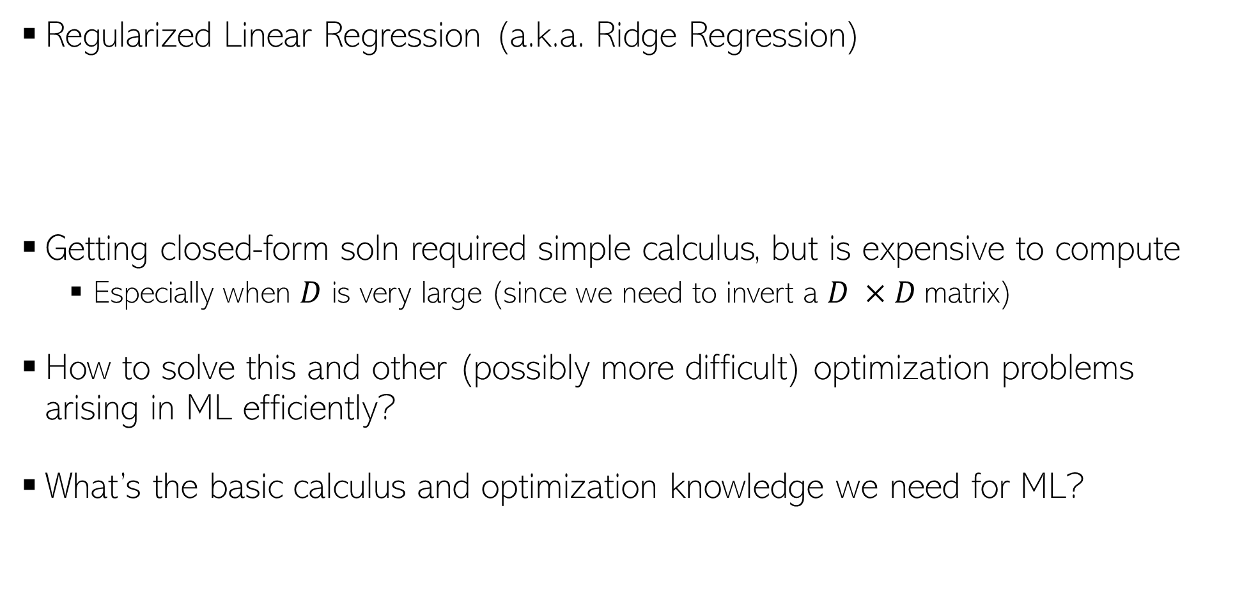
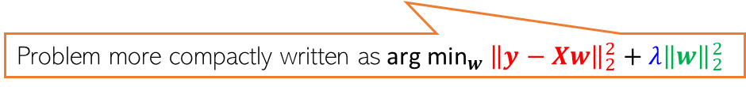
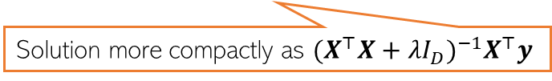
Calculus and Optimization for ML
2
Regularized Linear Regression (a.k.a. Ridge Regression)
Getting closed-form soln required simple calculus, but is expensive to compute
Especially when $D$ is very large (since we need to invert a $D ×D$matrix)
How to solve this and other (possibly more difficult) optimization problems arising in ML efficiently?
What’s the basic calculus and optimization knowledge we need for ML?
$w_{ridge}\text{=}{ \text{arg} \text{min}}_{w}\sum_{n=1}^{N}{{(y_{n}−w^{⊤}x_{n})}^{2}}+λw^{⊤}w={\left(\sum_{n=1}^{N}{x_{n} x_{n}^{⊤}+λI_{D} }\right)}^{−1}$ $(\sum_{n=1}^{N}{y_{n}}x_{n})$
Problem more compactly written as${ \text{arg} \text{min}}_{w} {\left\|y−Xw\right\|}_{2}^{2}+λ{\left\|w\right\|}_{2}^{2}$
Solution more compactly as ${(X^{⊤}X+λI_{D})}^{−1}X^{⊤}y$

Slide 3




Functions and their optima
The objective function of the ML problem we are solving (e.g., squared loss for regression)
Assume unconstrained for now, i.e., just a real-valued number/vector
Many ML problems require us to optimize a function $f$ of some variable(s) $x$
For simplicity, assume $f$ is a scalar-valued function of a scalar $x$($f:$ $ℝ →ℝ)$
Any function has one/more optima (maxima, minima), and maybe saddle points
Finding the optima or saddles requires derivatives/gradients of the function
$$f(x)$$
A local maxima
A local maxima
Global maxima
Usually interested in global optima but often want to find local optima, too
A local minima
For deep learning models, often the local optima are what we can find (and they usually suffice) – more later
A local minima
A local minima
$$x$$
Will see what these are later
Global minima

Slide 4

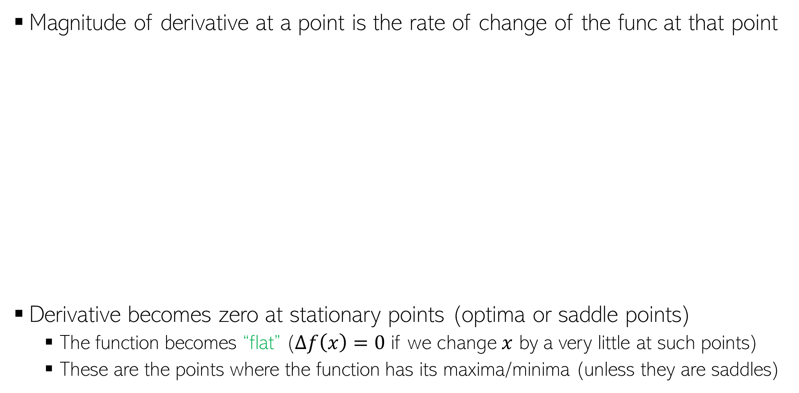

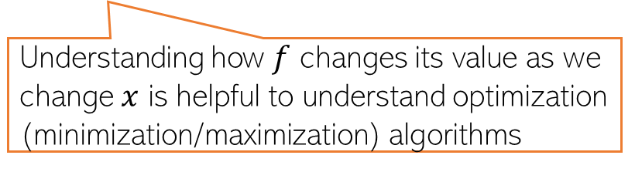

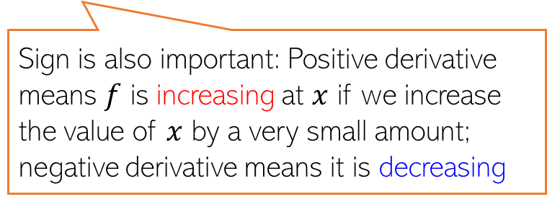


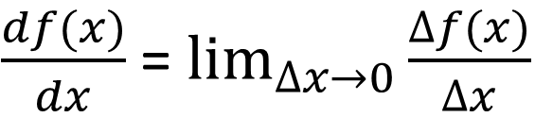


Derivatives
Will sometimes use $f^{′}(x)$ to denote the derivative
Magnitude of derivative at a point is the rate of change of the func at that point
Derivative becomes zero at stationary points (optima or saddle points)
The function becomes “flat” ($∆f\left(x\right)=0$ if we change $x$ by a very little at such points)
These are the points where the function has its maxima/minima (unless they are saddles)
$\frac{df(x)}{dx}$ = $\lim_{∆x→0}{\frac{∆f(x)}{∆x}}$
$$f(x)$$
Sign is also important: Positive derivative means $f$ is increasing at $x$ if we increase the value of $x$ by a very small amount; negative derivative means it is decreasing
$$∆f(x)$$
$$∆f(x)$$
$$∆x$$
$$∆x$$
$$x$$
Understanding how $f$ changes its value as we change $x$ is helpful to understand optimization (minimization/maximization) algorithms

Slide 5
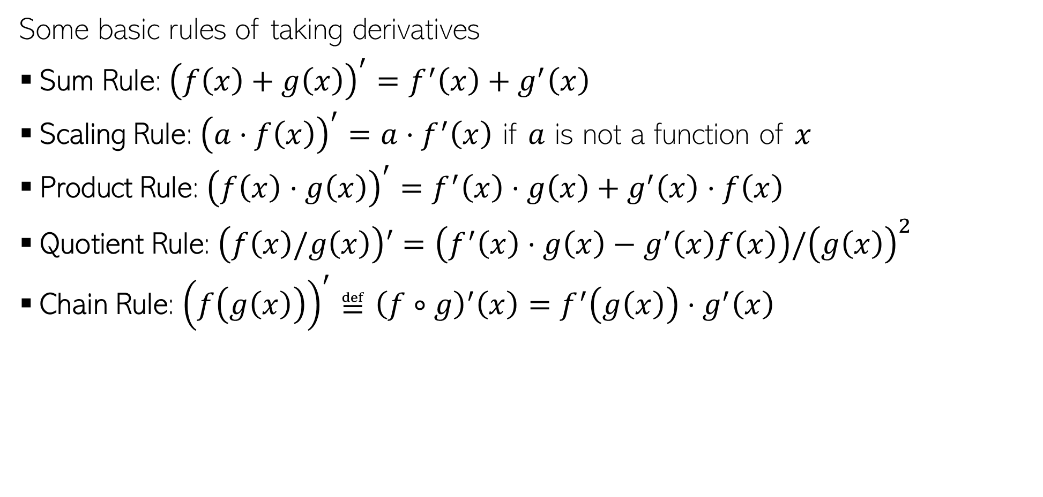
Rules of Derivatives
Some basic rules of taking derivatives
Sum Rule: ${\left(f\left(x\right)+g\left(x\right)\right)}^{′}=f^{′}\left(x\right)+g^{′}\left(x\right)$
Scaling Rule: ${\left(a⋅f\left(x\right)\right)}^{′}=a⋅f^{′}\left(x\right)$ if $a$ is not a function of $x$
Product Rule: ${\left(f\left(x\right)⋅g\left(x\right)\right)}^{′}=f^{′}\left(x\right)⋅g\left(x\right)+g^{′}\left(x\right)⋅f\left(x\right)$
Quotient Rule: $\left(f\left(x\right)/g\left(x\right)\right)′=\left(f^{′}\left(x\right)⋅g\left(x\right)−g^{′}\left(x\right)f\left(x\right)\right)/{\left(g\left(x\right)\right)}^{2}$
Chain Rule: ${\left(f\left(g\left(x\right)\right)\right)}^{′}≝{\left(f∘g\right)}^{′}\left(x\right)=f^{′}\left(g\left(x\right)\right)⋅g^{′}\left(x\right)$
We already used some of these (sum, scaling and chain) when calculating the derivative for the linear regression model

Slide 6
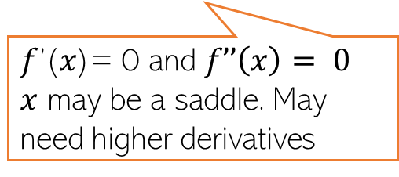
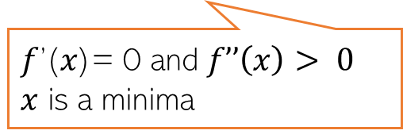
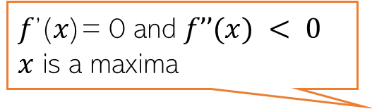

Derivatives
How the derivative itself changes tells us about the function’s optima
The second derivative $f’’(x)$can provide this information
𝑓’(𝑥)= 0 and $f’’(x) < 0$
$x$ is a maxima
𝑓’(𝑥)= 0 at 𝑥
𝑓’(𝑥)= 0 just before 𝑥 𝑓’(𝑥)= 0 just after 𝑥
𝑥 may be a saddle
𝑓’(𝑥)= 0 at 𝑥, 𝑓’(𝑥)>0 just before 𝑥 𝑓’(𝑥)<0 just after 𝑥
𝑥 is a maxima
𝑓’(𝑥)= 0 and $f’’\left(x\right)> 0$
$x$ is a minima
𝑓’(𝑥)= 0 and $f’’\left(x\right)= 0$
$x$ may be a saddle. May need higher derivatives
𝑓’(𝑥)= 0 at 𝑥
𝑓’(𝑥)< 0 just before 𝑥 𝑓’(𝑥)>0 just after 𝑥
𝑥 is a minima

Slide 7
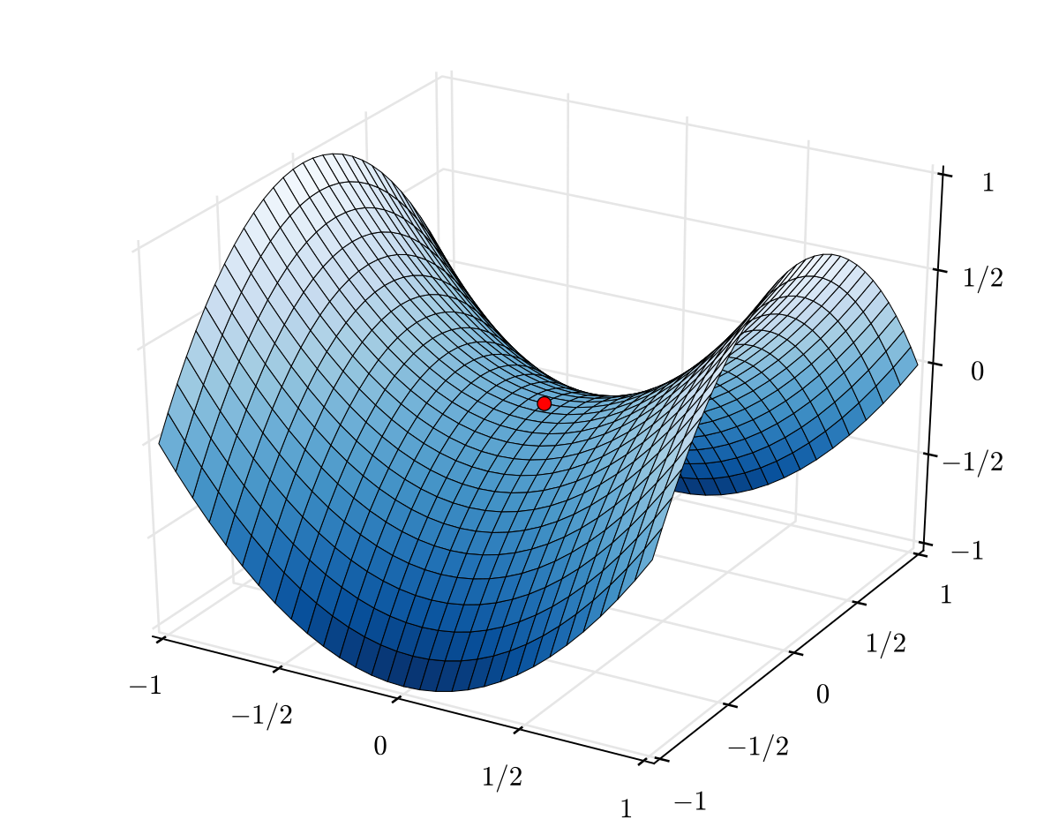
Saddle Points
Points where derivative is zero but are neither minima nor maxima
Saddle points are very common for loss functions of deep learning models
Need to be handled carefully during optimization
Second or higher derivative may help identify if a stationary point is a saddle
A saddle point
Saddle is a point of inflection where the derivative is also zero

Slide 8
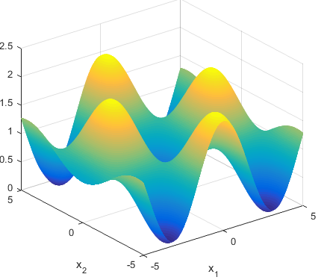

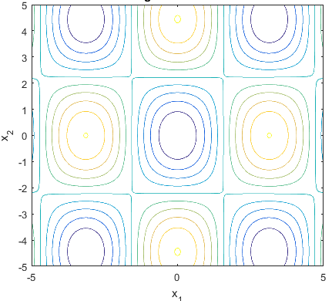


Multivariate Functions
Most functions that we see in ML are multivariate function
Example: Loss fn $L(w)$ in lin-reg was a multivar function of $D$-dim vector $w$
Here is an illustration of a function of 2 variables (4 maxima and 5 minima)
$L\left(w\right):ℝ^{D}$ $→ℝ$
Two-dim contour plot of the function (i.e., what it looks like from the above)
Plot courtesy: http://benchmarkfcns.xyz/benchmarkfcns/griewankfcn.html

Slide 9
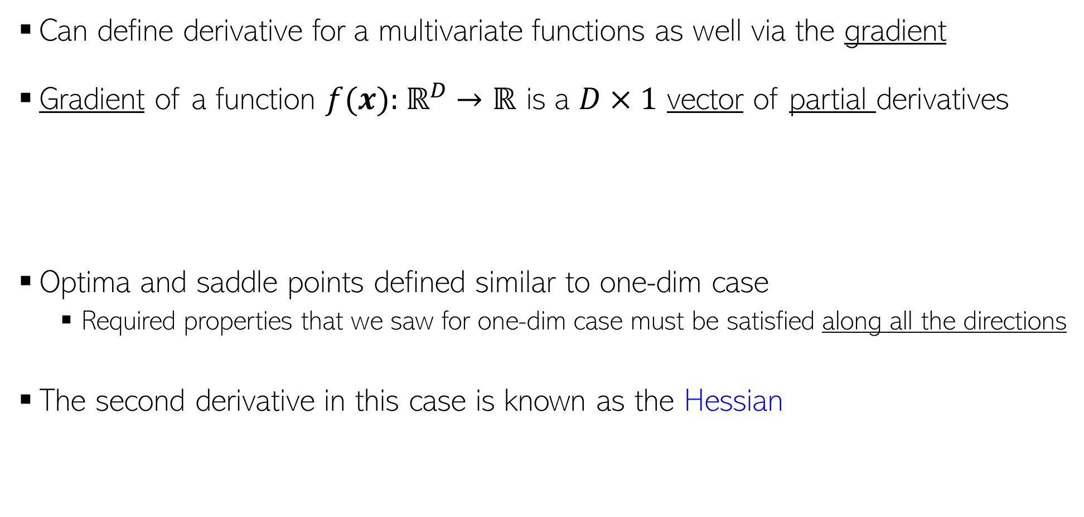
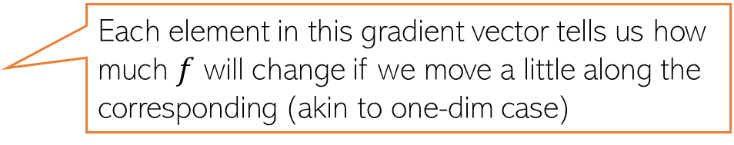
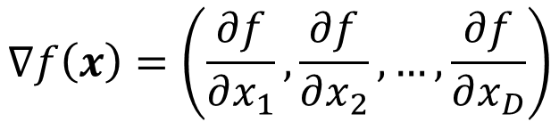
Derivatives of Multivariate Functions
Can define derivative for a multivariate functions as well via the gradient
Gradient of a function $f(x):$ $ℝ^{D}$ $→ℝ$ is a $D×1$ vector of partial derivatives
Optima and saddle points defined similar to one-dim case
Required properties that we saw for one-dim case must be satisfied along all the directions
The second derivative in this case is known as the Hessian
$$∇f\left(x\right)=\left(\frac{∂f}{∂x_{1}},\frac{∂f}{∂x_{2}},…,\frac{∂f}{∂x_{D}}\right)$$
Each element in this gradient vector tells us how much $f$ will change if we move a little along the corresponding (akin to one-dim case)

Slide 10
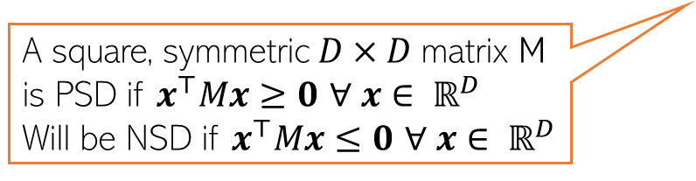

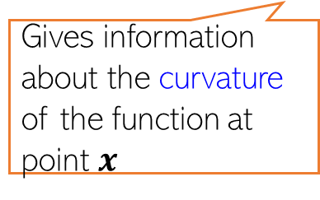


The Hessian
For a multivar scalar valued function $f(x):$ $ℝ^{D}$ $→ℝ$, Hessian is a $D× D$matrix
The Hessian matrix can be used to assess the optima/saddle points
$∇f\left(x\right)$ = 0 and $∇^{2}f\left(x\right)$ is a positive semi-definite (PSD) matrix then $x$ is a minima
$∇f\left(x\right)$ = 0, and $∇^{2}f\left(x\right)$ is a negative semi-definite (NSD) matrix then $x$ is a maxima
Note: If the function itself is vector valued, e.g., $f(x):$ $ℝ^{D}$ $→ℝ^{K}$ then we will have $K$ such $D× D$Hessian matrices, one for each output dimension of $f$
$$∇^{2}f\left(x\right)=\left[\begin{matrix}\begin{aligned}\frac{∂^{2}f}{∂x_{1}^{2}} \\ \frac{∂^{2}f}{∂x_{2}x_{1}}\end{aligned} & \begin{aligned}\frac{∂^{2}f}{∂x_{1}x_{2}} \\ \frac{∂^{2}f}{∂x_{2}^{2}}\end{aligned} & \begin{aligned}… \\ …\end{aligned} \\ ⋮ & ⋮ & ⋱ \\ \frac{∂^{2}f}{∂x_{D}x_{1}} & \frac{∂^{2}f}{∂x_{D}x_{2}} & …\end{matrix} \begin{matrix}\frac{∂^{2}f}{∂x_{1}x_{D}} \\ \frac{∂^{2}f}{∂x_{2}x_{D}} \\ \begin{aligned}⋮ \\ \frac{∂^{2}f}{∂x_{D}^{2}}\end{aligned}\end{matrix}\right]$$
Gives information about the curvature of the function at point $x$
A square, symmetric $D×D$matrix M is PSD if $x^{⊤}Mx≥0$ $∀ x∈ ℝ^{D}$
Will be NSD if $x^{⊤}Mx≤0$ $∀ x∈ ℝ^{D}$
PSD if all eigenvalues are non-negative

Slide 11
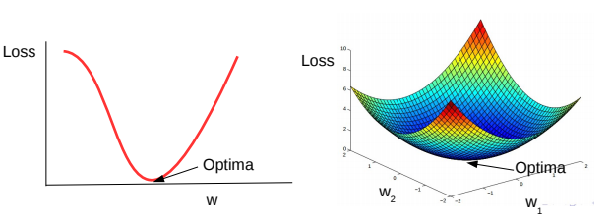
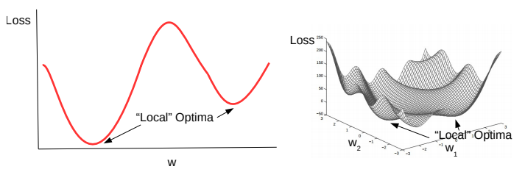
Convex and Non-Convex Functions
A function being optimized can be either convex or non-convex
Here are a couple of examples of convex functions
Here are a couple of examples of non-convex functions
Convex functions are bowl-shaped. They have a unique optima (minima)
Negative of a convex function is called a concave function, which also has a unique optima (maxima)
Non-convex functions have multiple minima. Usually harder to optimize as compared to convex functions
Loss functions of most deep learning models are non-convex

Slide 12
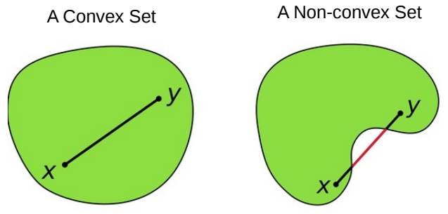
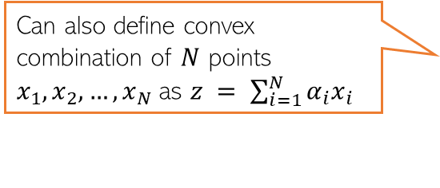

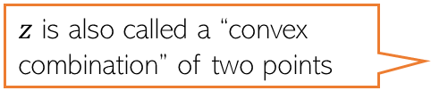

Convex Sets
A set S of points is a convex set, if for any two points $x, y ∈ S$, and 0 ≤ $α$ ≤ 1
Above means that all points on the line-segment between $x$ and $y$ lie within $S$
The domain of a convex function needs to be a convex set
$z$ is also called a “convex combination” of two points
Can also define convex combination of $N$ points $x_{1},x_{2},…,x_{N}$as $z = \sum_{i=1}^{N}{α_{i}x_{i}}$
$$z=αx+\left(1−α\right)y∈S$$

Slide 13
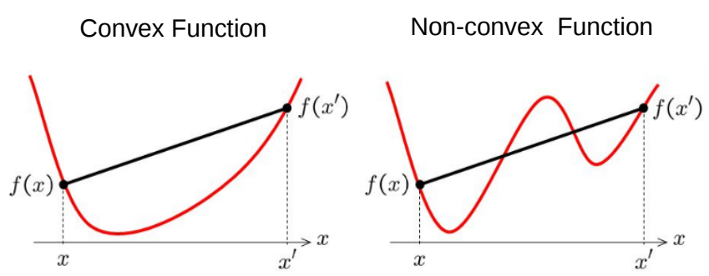
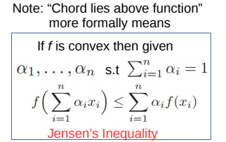
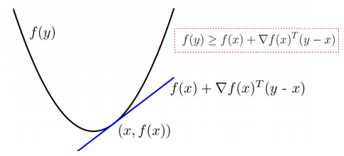

Convex Functions
Informally, $f(x)$ is convex if all of its chords lie above the function everywhere
Formally, (assuming differentiable function), some tests for convexity:
First-order convexity (graph of $f$ must be above all the tangents)
Second derivative a.k.a. Hessian (if exists) must be positive semi-definite
Exercise: Show that ridge regression objective is convex

Slide 14
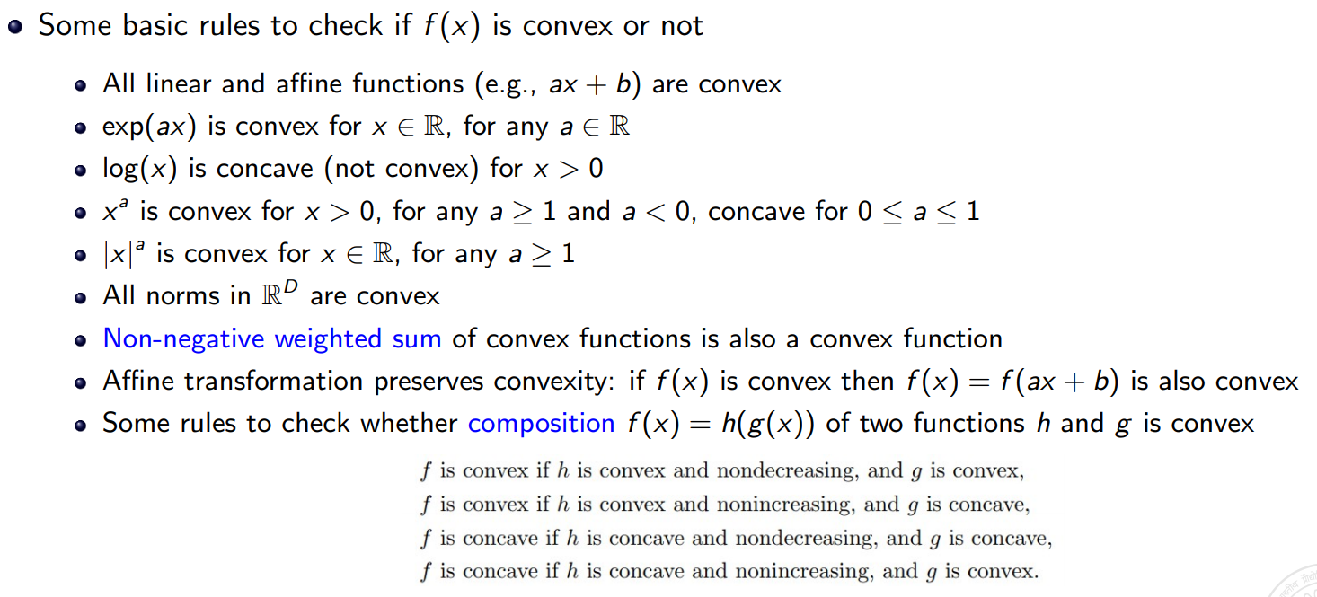
Some Basic Rules for Convex Functions

Slide 15
Coming up next
Gradients when the function is non-differentiable
Solving optimization problems
Iterative optimization algorithms, such as gradient descent and its variants

